Slide 1
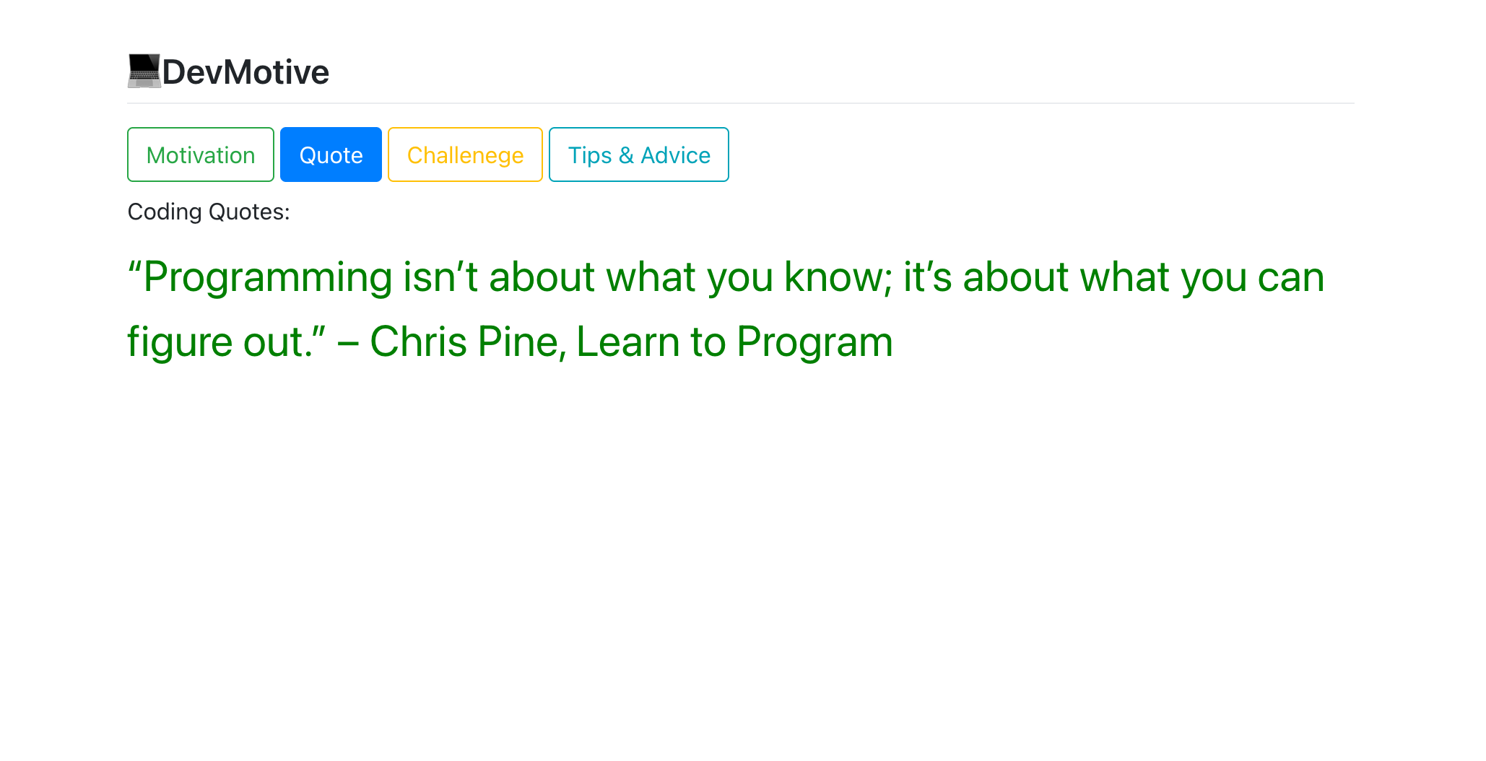

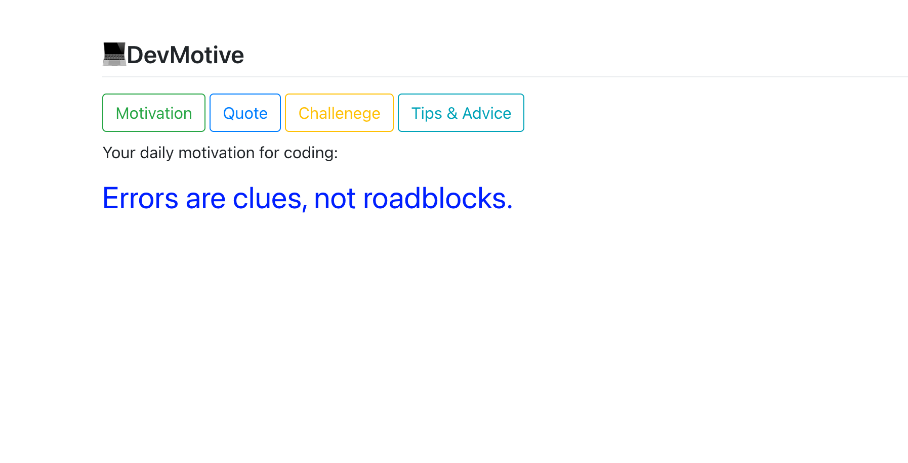
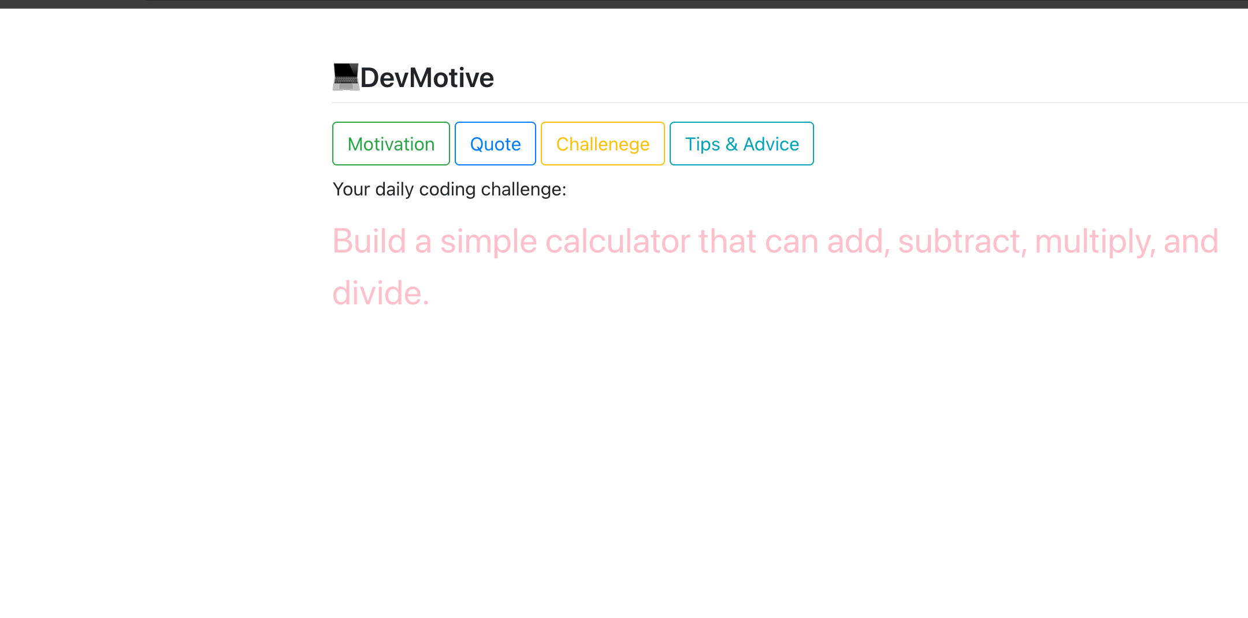
DEVMOTIVE Web Application by: Delanie Pacheco https://github.com/ksu-is/DevMotive
As a student first learning how to code, it can be intimidating. Devmotive is here to help you stay motivated with messages and words of advice any beginner needs. You can also find inspiring quotes and challenges you can try to keep you on track for your coding career with the click of a button!

